Slide 1
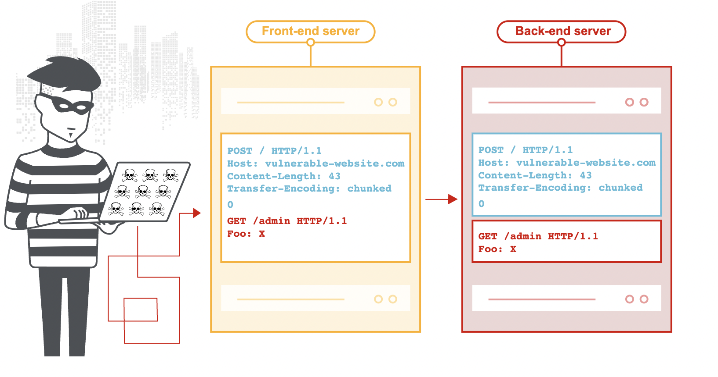
HTTP Request Smuggling
A Survey from HTTP/1.1 to HTTP/2.0
Vaibhav Singh

Slide 2

Agenda
Classification Criteria
Pre-requisite Knowledge Transfer
What is HTTP Request Smuggling?
Types of HTTP Request Smuggling
HTTP/1.1 attack exploitation scenarios
Historical Info
HRS Reborn and some Case studies
HTTP/2.0 Request Smuggling
Background and Case studies
Conclusion

Slide 3

Classification Criteria

Slide 4
Broadly covered
Superficially covered
Not covered
Intermittent, Short-Duration, High Frequency Attacks
HTTP/1.1
Bypass
Mitigation
Attacks
Attack Traffic Masquerading as Legitimate Traffic
HTTP
Request
Smuggling
HTTP/2.0
Small-Sized, Multiple Destination IP Attacks
HTTP/3.0
Notes:
Mitigation bypass is a process of fighting against and breaking mitigation measures in an environment where mitigations are enabled for the ultimate end of arbitrary code execution.
Intermittent short range high frequency – SYN attack
Small sized Multiple Destination IP attacks – PMTU related ICMP attacks

Slide 5

Prerequisite Knowledge Transfer

Slide 6
HTTP/1.1 Body Transfer
Methods of signaling the end of the HTTP request.
Content Length Header | Chunked encoding
Content Length : 100 “Well!! Here goes 100 bytes of the request body!!“ | Transfer-encoding: Chunked ff ( length of chunk in hex format) Here goes 255-byte chunk 10 Another chunk 0
Notes:
In case of chunked encoding, 0 signifies the end of request followed by \r\n
\r\n

Slide 7

HTTP Request Smuggling

Slide 8
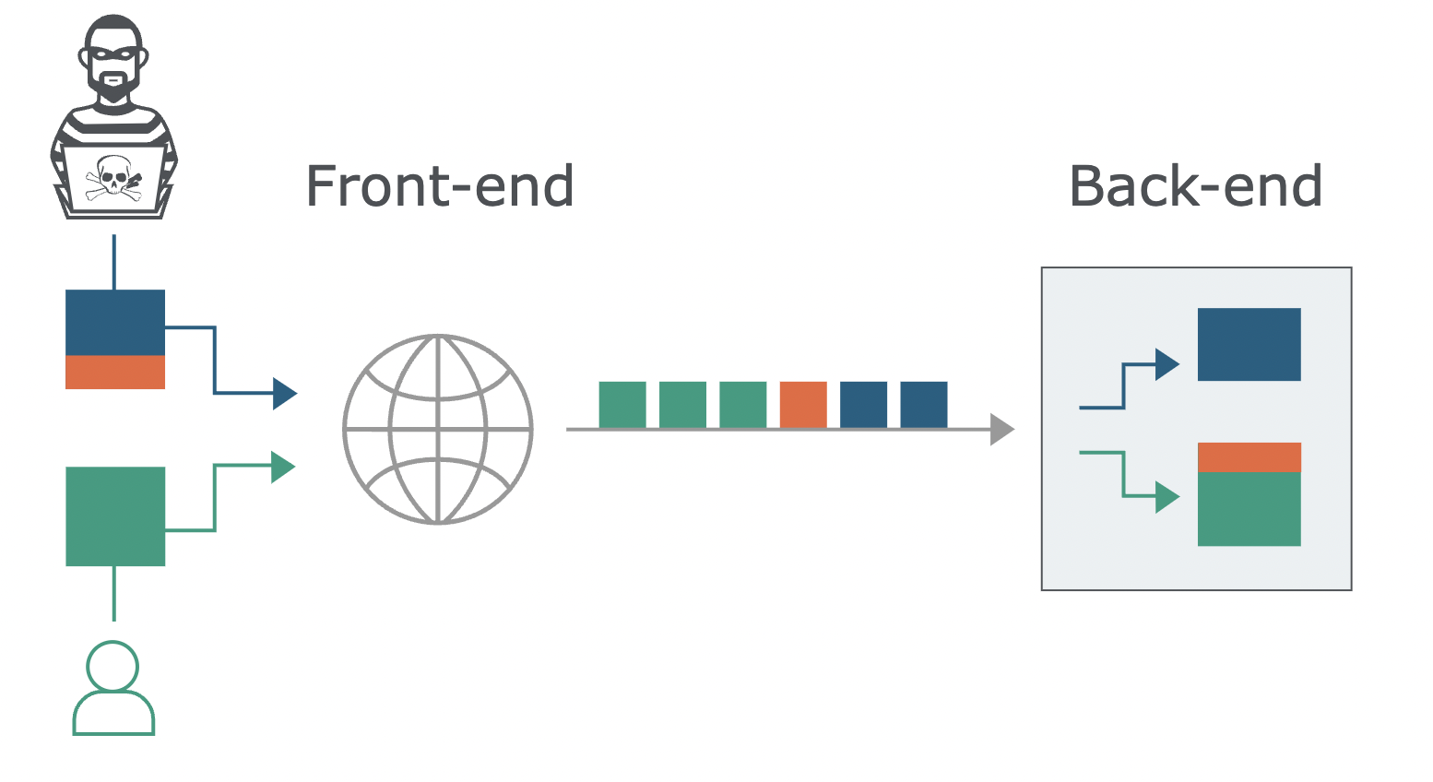
“Technique for interfering with the way a website processes
sequences of HTTP requests”
( Mitigation Bypass attack )
Attacker sends malicious request
Parsed as single request by the
front-end
Forwarded to backend
Backend parses it as two
different requests
Notes:
Mitigation bypass is a process of fighting against and breaking mitigation measures in an environment where mitigations are enabled for the ultimate end of arbitrary code execution

Slide 9
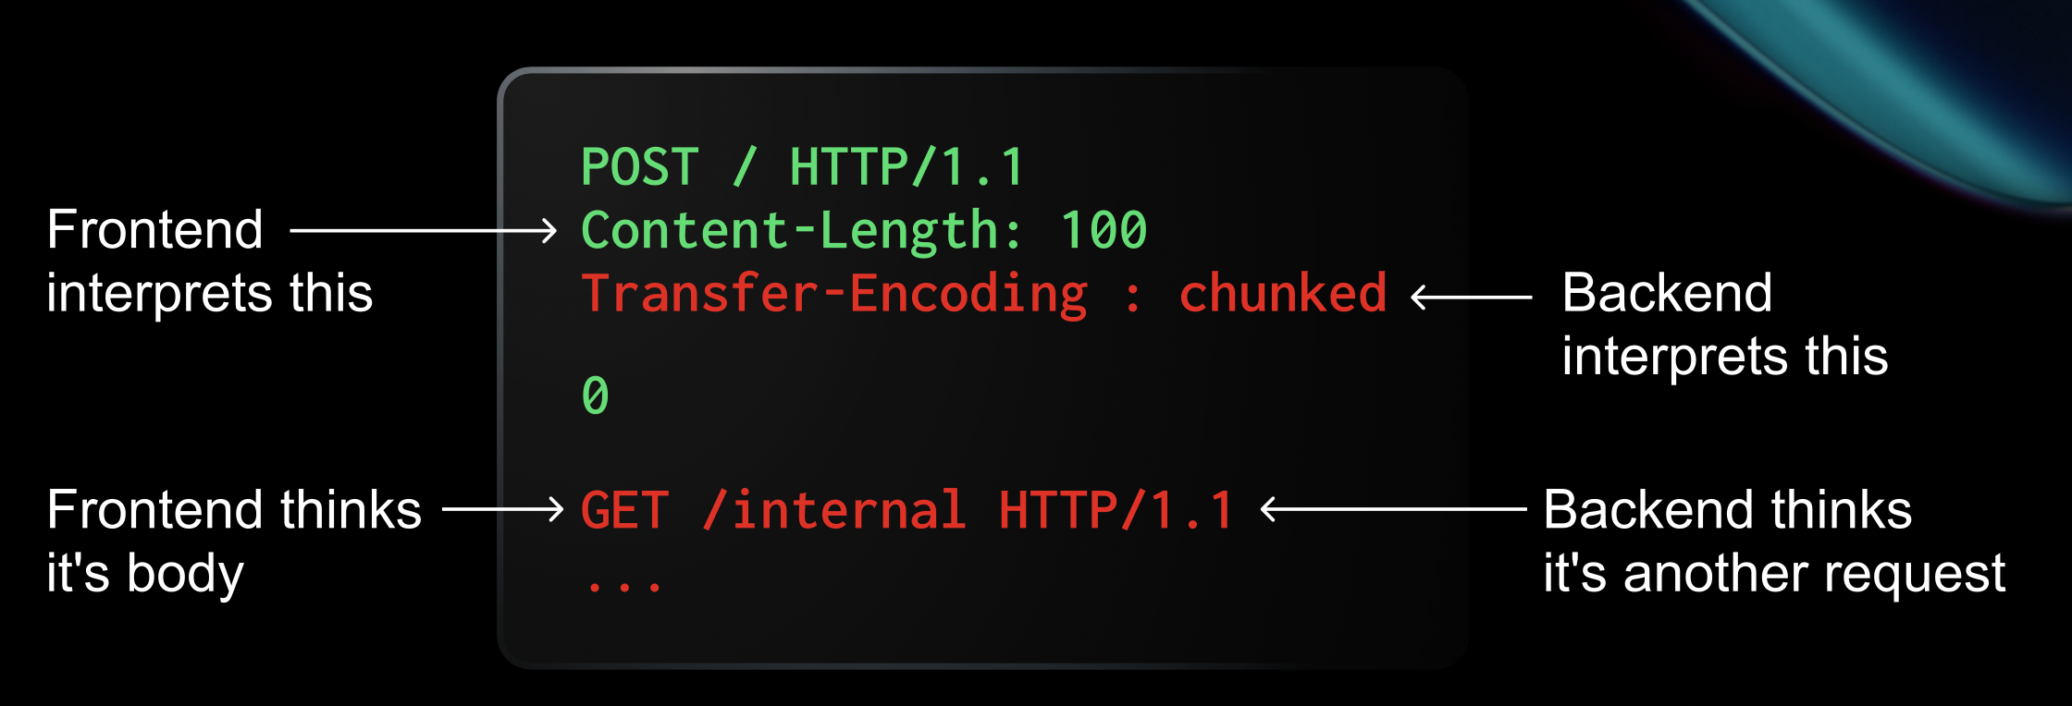
“It's all a game of Content-Length / Transfer-Encoding combination”
Transfer-Encoding has precedence
We need to "smuggle" Transfer-Encoding to backend unprocessed by the frontend
Allows threat actors to bypass security controls and gain unauthorized access to sensitive information and directly compromise other users.
Notes:
HTTP request smuggling vulnerabilities arise when the frontend and the backend interpret the boundary of an HTTP request differently causing desynchronization between them. This is due to numerous frontend and backend libraries deviating from RFC specifications when dealing with both the Content-Length and the Transfer-Encoding header.

Slide 10
Types of HTTP Request Smuggling
Front end | Back end | Acronym
Content-Length | Transfer-Encoding | CL.TE
Transfer-Encoding | Content-Length | TE.CL
Transfer-Encoding | Transfer-Encoding | TE.TE

Slide 11


CL.TE : Frontend - CL, Backend: TE
POST / HTTP/1.1
Host: vulnerable-website.com
Content-Length: 13
Transfer-Encoding: chunked
\n
0\n
\n
SMUGGLED\n
Backend
interprets
this
Frontend
interprets
this
Notes:
Frontend doesn’t understand chunked encoding hence treats that line as a header
Sees that content length is 13 and sends thinking its one request
Backend sees chunked and notices value 0
Append SMUGGLED to the other POST request thinking that is the body and sends to the backend API

Slide 12


TE.CL : Frontend - TE, Backend: CL
POST / HTTP/1.1
Host: vulnerable-website.com
Content-Length: 3
Transfer-Encoding: chunked
\n
8\n
SMUGGLED\n
0
Backend
interprets
this
Frontend
interprets
this

Slide 13
TE.TE Obfuscate the TE Header
Transfer-Encoding: xchunked
Transfer-Encoding : chunked
Transfer-Encoding: chunked Transfer-Encoding: x
Transfer-Encoding:[tab]chunked
[space]Transfer-Encoding: chunked
X: X[\n]Transfer-Encoding: chunked
Transfer-Encoding : chunked
Both frontend and backend supports Chunked encoding here!!
Induce one server to process and other to not process by obfuscation!
Different real-world implementations have subtle deviations from RFC specifications!!

Slide 14

HTTP/1.1 attack exploitation scenarios
Access internal endpoints
Bypassing security filters
Cache poisoning
Replacement of regular response
Credentials hijacking
Stealing user requests

Slide 15
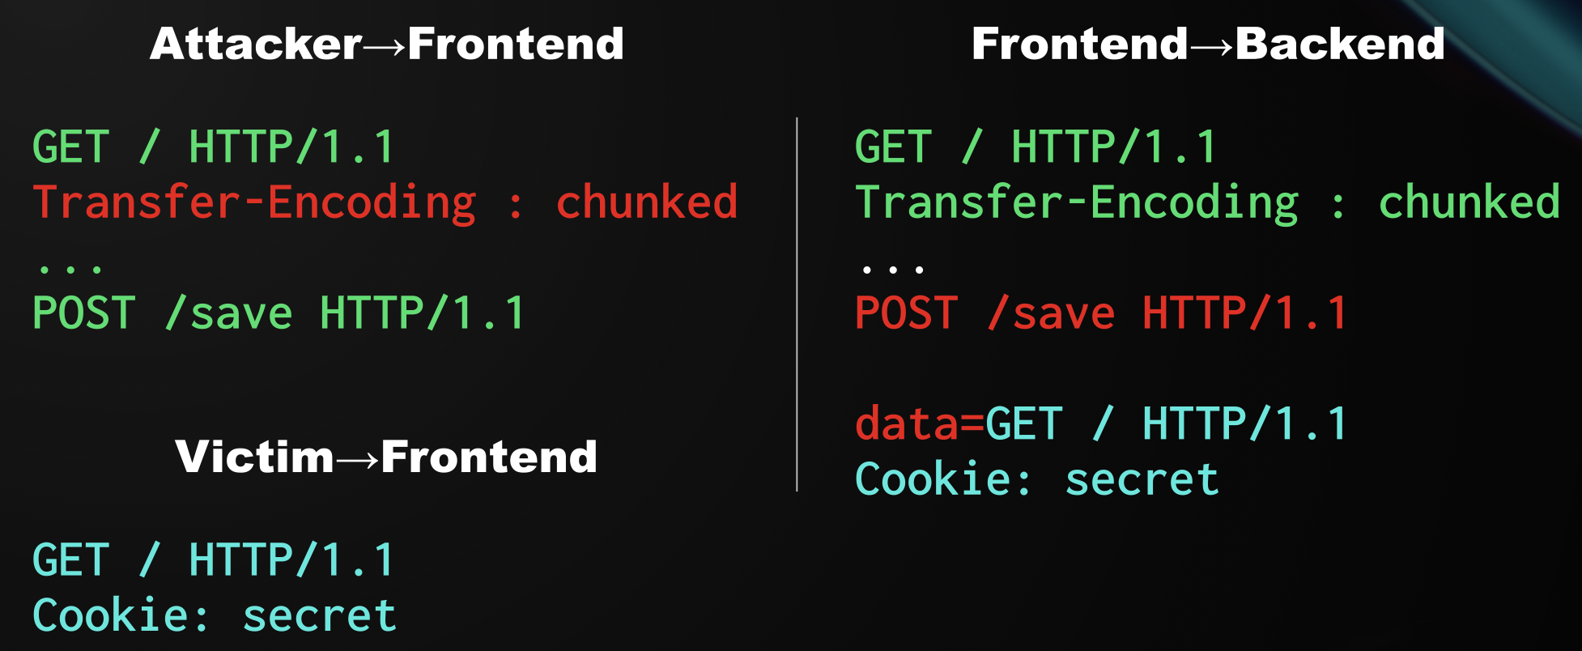
Credentials hijacking
[Src : Positive hack days]

Slide 16
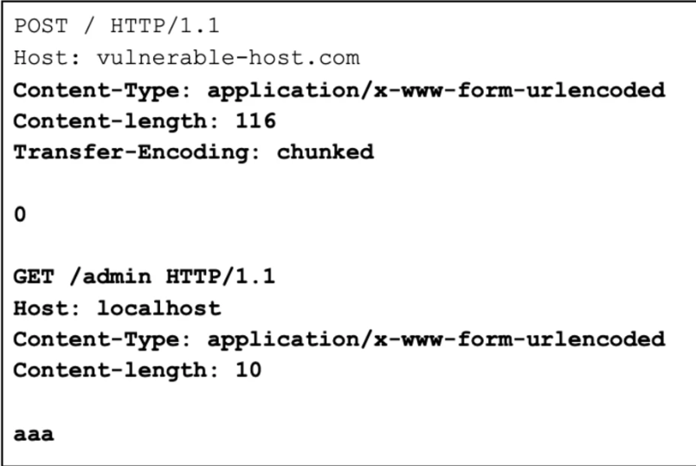
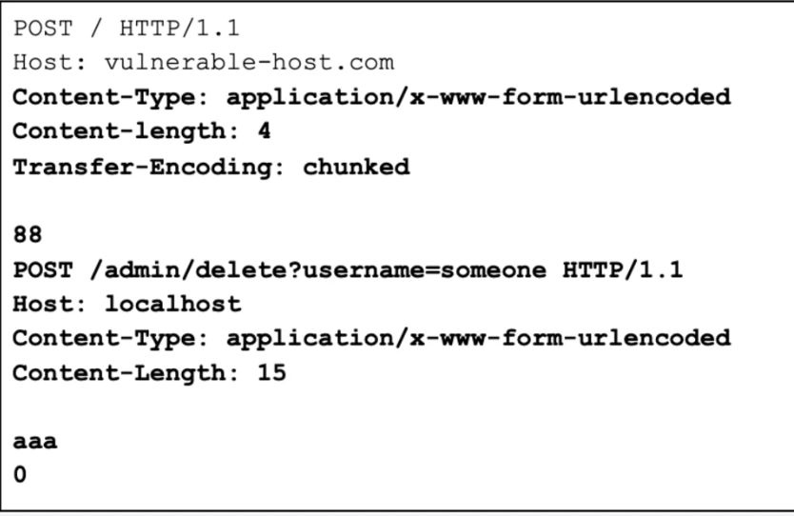
Bypass frontend security
https://www.cobalt.io/blog/a-pentesters-guide-to-http-request-smuggling

Slide 17

Historical Info
and
HTTP Request Smuggling
Reborn
The HTTP Desync attack

Slide 18
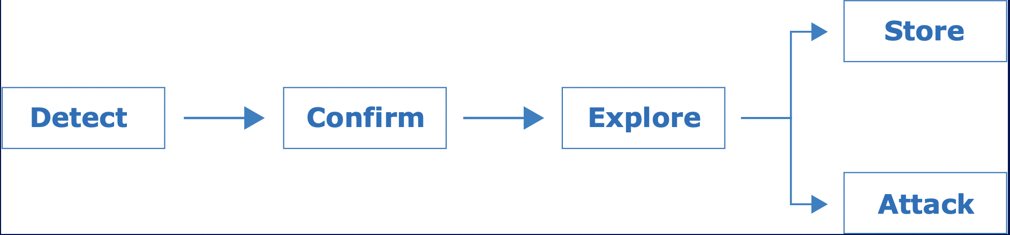
2005
HRS was first documented by Watchfire
The collateral damage was so severe that it was left unattended for years
Meanwhile web susceptibility kept growing
2019
James Kettle delivered a series of sessions at DefCon and RedHat
Published detailed articles and labs on PortSwigger.
Provided details about various tools and methods for reliable black box detection with minimal collateral damage!!
Methodology to hunt HRS

Slide 19
Some bug bounties – James Kettle!!
New Relic ( Golang Proxy + Njinx Server)
An F5 vulnerability!!
https://support.f5.com/csp/article/K50375550
https://hackerone.com/reports/498052
The specific scenario described by this Advisory occurs when, and only when:
The client sends a series of specifically crafted, malformed HTTP requests that do not conform to HTTP RFCs (for example, RFC7230, RFC2616).
The target pool member web server also accepts and processes these requests, despite their non-conformance to RFCs.
In this scenario, the vulnerable pool member web server may interpret the stream of requests differently to the BIG-IP system and may take unintended actions based on the stream of requests.

Slide 20
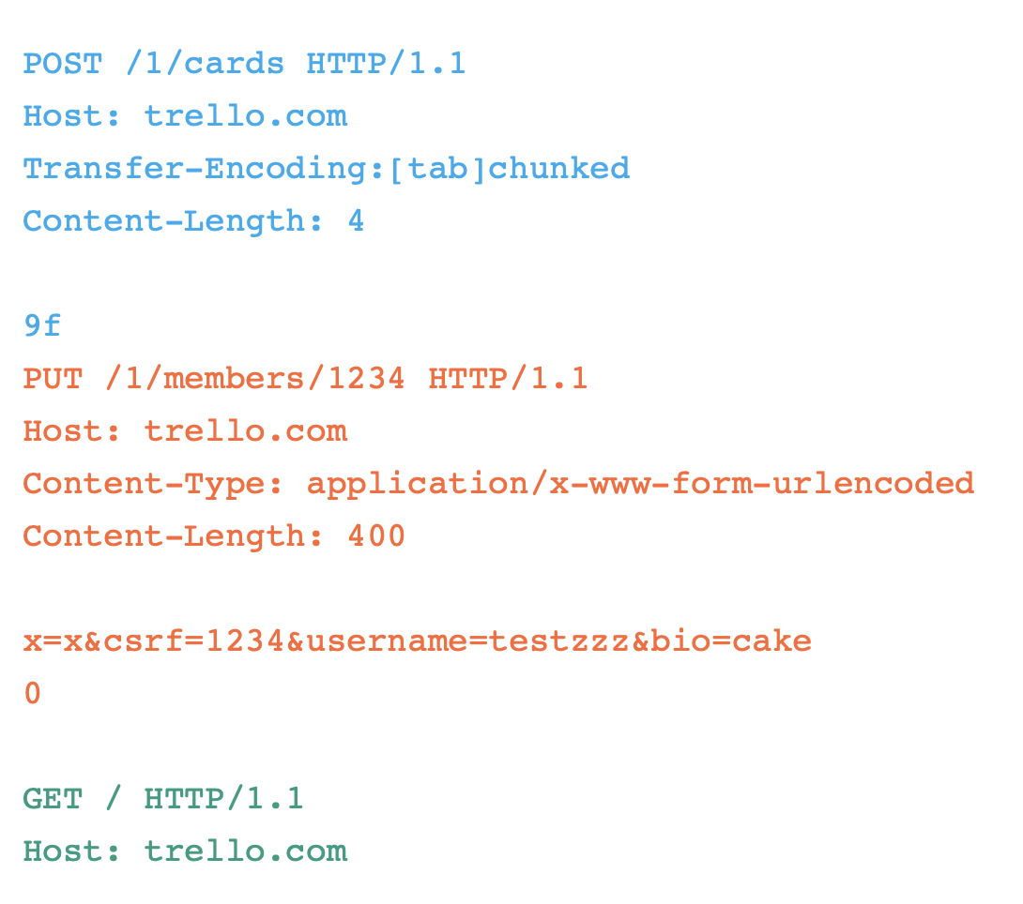
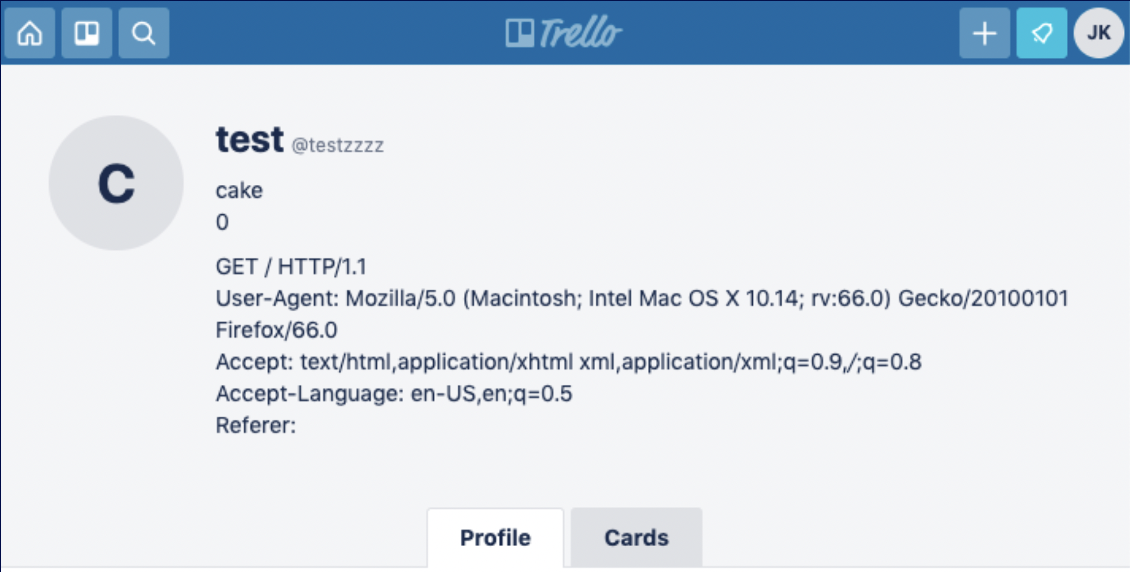
Applications with store/edit functionality The Trello vulnerability
https://portswigger.net/research/http-desync-attacks-request-smuggling-reborn

Slide 21
Overall, James Kettle led to the rebirth
of research on the feared HTTP Request
Smuggling attack!!
https://portswigger.net/research/cracking-the-lens-targeting-https-hidden-attack-surface
https://portswigger.net/research/http-desync-attacks-request-smuggling-reborn
https://portswigger.net/research/http-desync-attacks-request-smuggling-reborn
https://www.youtube.com/watch?v=_A04msdplXs
https://www.youtube.com/watch?v=zP4b3pw94s0

Slide 22

HTTP/2.0 Request Smuggling
(h2c Smuggling)

Slide 23
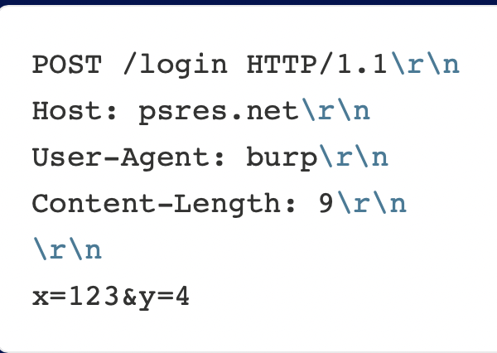
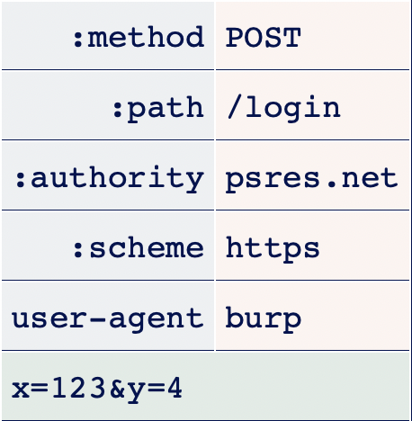
“HTTP/2.0 is complex but it’s designed to transmit the same
information as HTTP/1.1”
HTTP/1.1 | HTTP/2.0
First line provides request method and path | Series of Pseudo Headers
Text based Protocol Request Parsing needed Ambiguity drives HRS | Binary Protocol like TCP Has structured format HTTP messages are sent as frames ( like TCP packets) Less prone to ambiguity
Length is indicated by Content-Length or Transfer-encoding forms the crux of HRS 1.1 | Data frames have built-in length Little room for length-based ambiguity
HTTP/1.1
Everything is so perfect!!! So, how are HTTP/2.0 desync
attacks even possible??
Answer : HTTP/2 Downgrading
HTTP/2
Notes:
People in the industry know that HTTP/2.0 was kind of a rushed complex protocol and has lots of imperfections which had led to various interpretations and faulty implementations.
But it was almost touted as a safe and secure protocol as similar as TCP from the transport

Slide 24
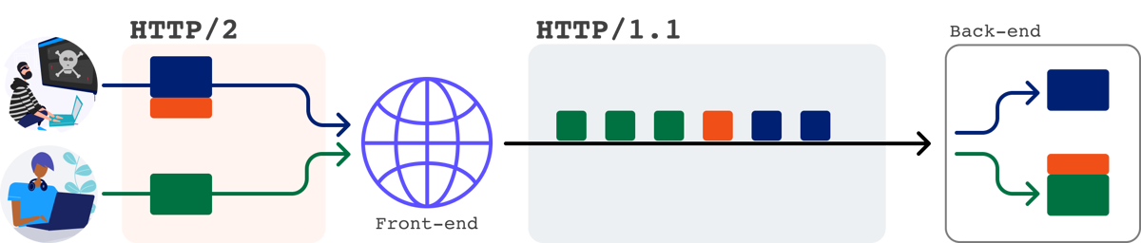
HTTP/2 downgrading
Front-end speaks HTTP/2 with clients
FE Rewrites requests into HTTP/1.1 before forwarding to backend
https://portswigger.net/research/http2
Notes:
As I showed you in the previous slides, the disagreement between TE and CL forms the basis for classical HRS

Slide 25
Front end uses HTTP/2
Message Length for
boundary estimation
+
Back end = downgraded HTTP/1.1
Uses CL/TE for boundary
estimation
Disparity
H2.TE
H2.CL

Slide 26
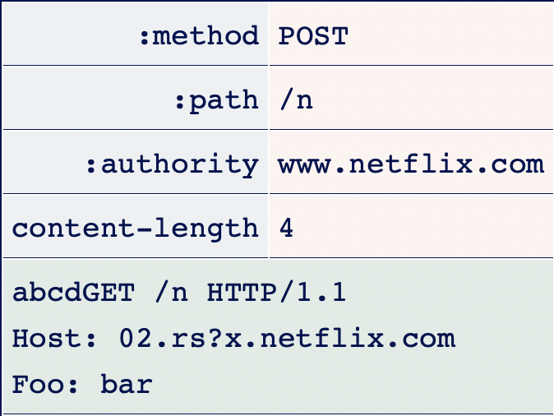
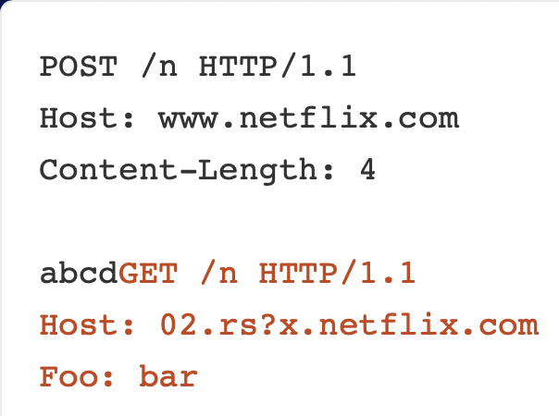

Case Studies – The Netflix H2.CL desync
“HTTP/2.0 RFC states that CL is not needed but allowed if it’s correct”
Frontend performs HTTP
downgrade without
verifying content length
https://portswigger.net/research/http2
Notes:
Thanks to the incorrect Content-Length, the back-end stopped processing the request early and the data in orange was treated as the start of another request.

Slide 27
The extent of severity?
Using crafted prefix,
user requests can be redirected
to attacker’s server!!
Potential to steal all Netflix account
credentials and credit card information !!
Notes:
Netflix awarded their maximum bounty - $20,000.
https://github.com/Netflix/zuul/pull/980

Slide 28
Case Studies – AWS H2.TE desync
The RFC states "any message containing connection-specific header fields MUST be treated as malformed”
Transfer encoding is a connection specific header field, but AWS LB failed to obey this suggestion
Almost every website using AWS could be exploited using H2.TE desync

Slide 29
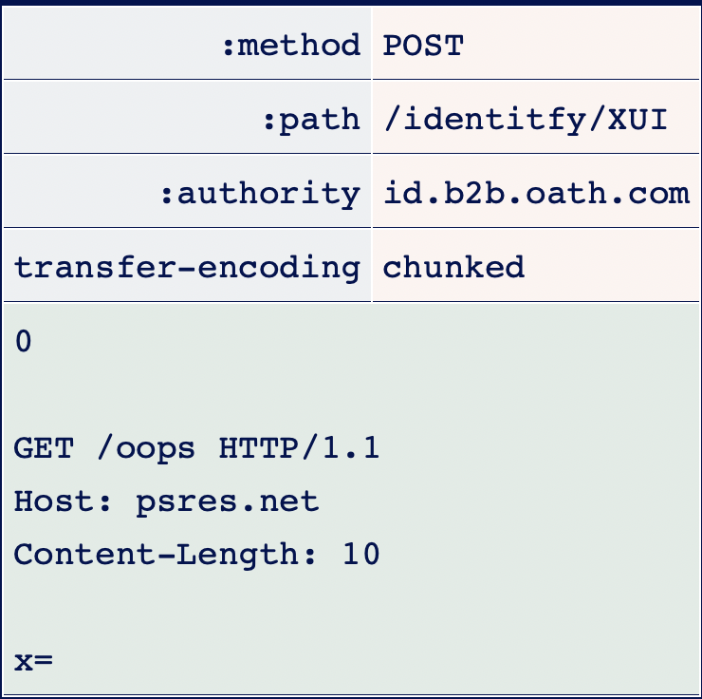
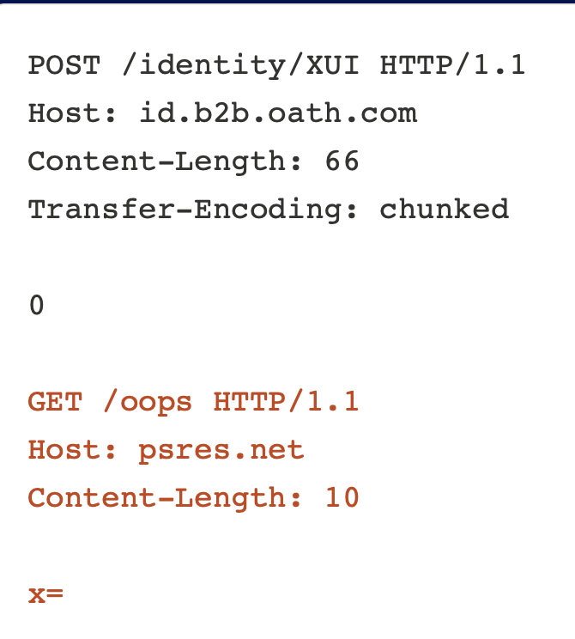
Redirect enables credential hijacking

Slide 30
Conclusion
HTTP/2 complexity has led to implementation shortcuts
Tons of issues are reported on a frequent basis and many go unreported
Apple + Citrix vulnerability (unreported)
200k bug bounty!!
There’s a push to move towards HTTP/3.0 but new HRS issues are already being researched there!

Slide 31

Questions?

